Slide 1
Monte Carlo on Ice: How Simulation can Help Figure Skating Medalist
James Lee (jlee73@ncsu.edu)

Slide 2
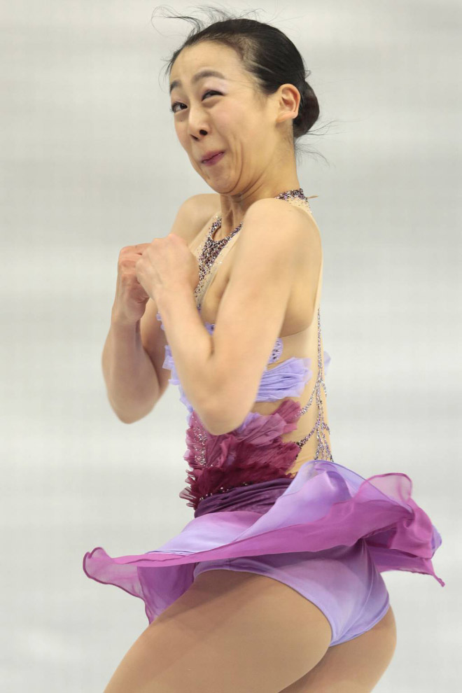
Why doing this project?
More Memes
Understanding how figure skating is scored and how skaters win.

Slide 3
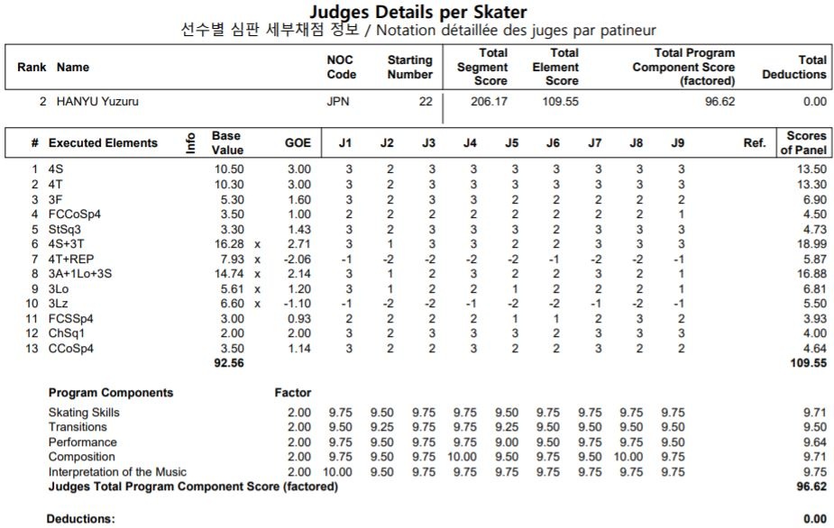
How figure skating is scored

Slide 4
Purpose and Impact
Purpose
More objective and make every jump accountable for.
Limitation on aesthetic scoring (AES)
Impact
Rewarding high based-value jumps (4Lo, 3A…)
Back-loading

Slide 5
Which jump is better?

Slide 6
Back-loading
Getting 10% more BV if jumps are performed in second half
The original purpose is to compensate the extra stamina and risk.
However, some skaters use this loophole to put all of the jumps in the second half in the hope of getting more BV.

Slide 7
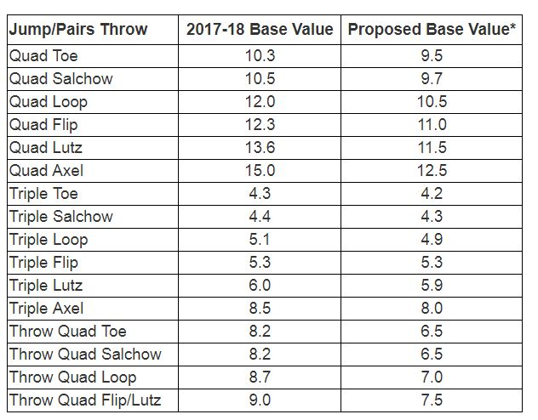
Recent rule changes
Base value change
Extended GOE
(-3~+3 → -5~+5)

Slide 8
Agenda
Method
Benchmark
Comparisons
Results
Review Cases

Slide 9
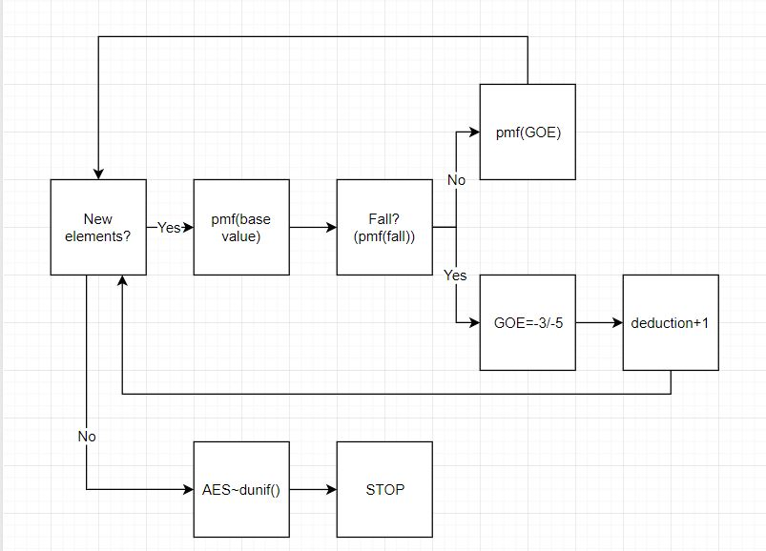
Method

Slide 10
Method
Data: Historical Free Skating results of Yuzuru Hanyu
BV and GOE: Generated by empirical distribution.
AES score:
Simulation of 9 judges, each give a score of discrete uniform distribution.
The score is determined by the average of the middle 7 scores.
Notes:
5 point advantage to low TES program

Slide 11
Benchmark in Free Skating
World Record – 223.2 (Yuzuru Hanyu)
2018 Olympics Best FS – 215.08 (Nathan Chen)
Top 3 in Olympics – 202.73 (Shoma Uno)
Top 10 in Olympics – 171.41 (Adam Rippon)

Slide 12
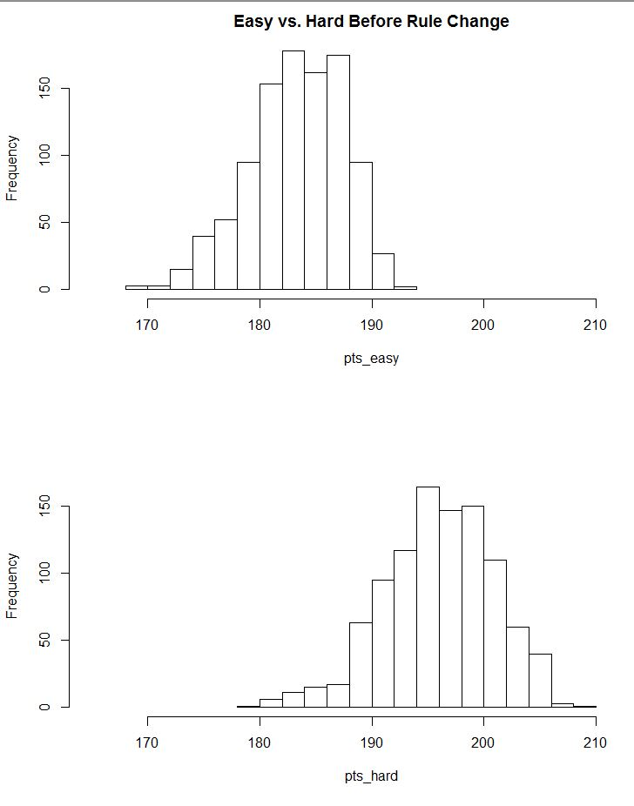
Comparisons
Easy Program w/AES+.5:
-Mean:183.35
-Max:194.82
Hard Program:
-Mean:195.80
-Max:207.35
The hard program wins 96.4% of the simulations

Slide 13
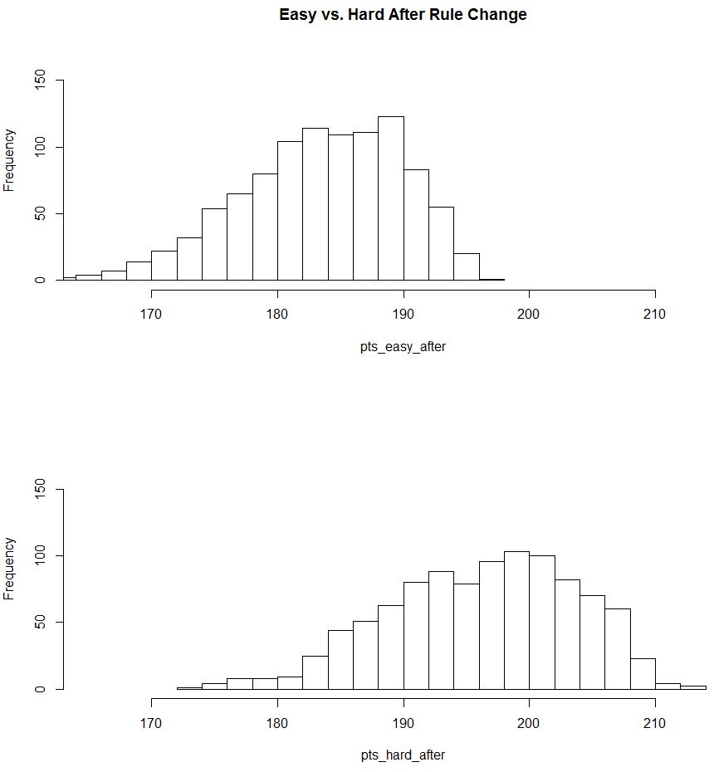
Comparisons
Easy Program w/AES+5:
-Mean:183.76
-Max:197.51
Hard Program:
-Mean:196.10
-Max:212.41
The hard program wins 89.8% of the simulations

Slide 14
Results
Risk vs Reward: High BV jumps now have to bear more risk since a fall will significantly harm the technical score.
Possibility to achieve WR: Extended GOE also gives skater a higher maximum score.
Less challenging jump: New jump like 4A may be discouraged.

Slide 15
Case 1: High and Low BV jump Nathan Chen vs. Jason Brown
Nathan Chen is the first man to complete five quad jumps in a program in Four Continents Championship 2017.
At the same time, Jason Brown complete a program without any quad jumps.
Before rule change, Nathan’s technical score is 36.12 points higher than Jason’s.
If the new rules is applied, the difference is narrowed down to 29.95 points.

Slide 16
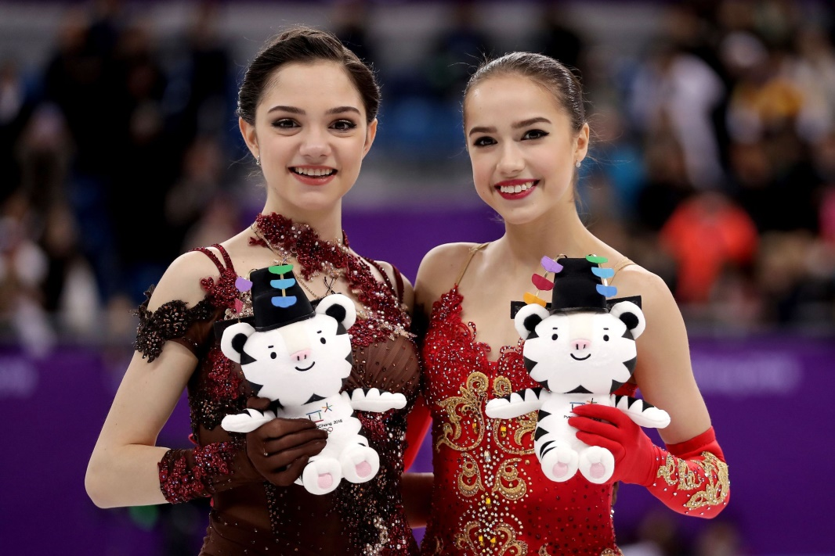
Case 2: Backloading Program Alina Zagitova vs. Evgenia Medvedeva
Neck to neck: Score exactly same points (156.65) in FS, Winter Olympics 2018.
However Alina backloaded all the jumps to second half

Slide 17
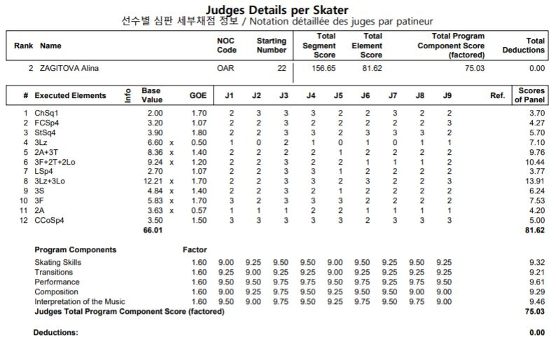

Slide 18
Why rule change won’t help in backloading
Compare to Quad/Triple jumps, where quad may be unobtainable for a skater, backloading is always an option
Impossible to balance since different player bears different risk.
The idea of “unbalanced program” is quite subjective.

Slide 19
IMPROVEMENTS
Using transition matrix between the status of the jumps (full, downgraded, fall)
Correlation between BV. GOE. AES. Elements
Ex. Higher BV jump tends to grab more GOE & AES
A judge may have bias to a skater

Slide 20
Special Thanks/ Credits
ISU https://www.isu.org/ and JSF https://www.skatingjapan.or.jp/ for the datasets and guidance on rule books
https://pbs.twimg.com/profile_images/823262406453432321/vbVWhE9G.jpg Marai Nagasu Meme Picture
https://www.youtube.com/watch?v=i6pw07k3GkM GIFs on point difference in 3A and 2A
https://hips.hearstapps.com/ghk.h-cdn.co/assets/18/08/4000x2666/gallery-1519418120-gettyimages-923198406.jpg?resize=2511:* Alina Zagitova and Evgenia Medvedeva picture

Slide 21
Q&A!

